Slide 1
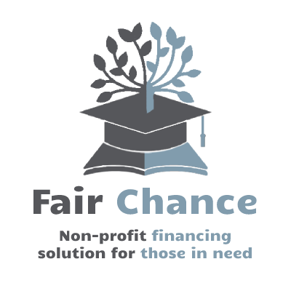
Fair Chance
Non-profit “last-stretch” financing for those in need
Bryan Denq • Christopher Denq • Mark Lovett

Slide 2
Fair Chance
Non-profit “last-stretch” financing for those in need
Intro
Problem
Customer
Competition
Solution
Financials
Current
Call-to-Action
Conclusion

Slide 3
Education Is Vital, but Expensive
“Education is very important for life improvement”¹
Stable income, health improvements, better wellbeing, stronger citizenship
As education price goes up, so does student debt
Average yearly tuition²: private $38k, public: $11k
1.7 trillion dollars of student debt among 45 million debtors³
Intro
Problem
Customer
Competition
Solution
Financials
Current
Call-to-Action
Conclusion
Notes:
For-profit lending is a $446.2B industry1
[1] Andrew Latham CFP®( Managing Editor) Andrew is the Content Director for SuperMoney. (2021, December 9). 2021 Student Loan Industry Study. SuperMoney. Retrieved May 18, 2022, from https://www.supermoney.com/studies/student-loan-industry-study/#:~:text=SuperMoney%20estimates%20the%20size%20of,%2486.1%20billion%20in%20private%20loans.

Slide 4
Problems with Educational Loans
For-profit lending too pricey
5.80%⁴ - 13+%⁵ interest
2) Federal lending too selective + does not give enough aid
FAFSA on average fall $2k short of tuition costs⁶
FAFSA admits that their given aid is insufficient⁷
Preliminary survey of fellow students partaking in financial aid:
86% said there were problems; 27% said extreme problems
Intro
Problem
Customer
Competition
Solution
Financials
Current
Call-to-Action
Conclusion
Notes:
13/15 survey, 4/15
Rest of federal funding is federal loans

Slide 5

We’re Focusing on Students
We want to help students:
want an education but cannot afford it
did not get enough from FAFSA aid
have been overlooked in the financial aid system
Intro
Problem
Customer
Competition
Solution
Financials
Current
Call-to-Action
Conclusion
Notes:
transition: because we have a personal connection to this issue, we are specifically looking to target students

Slide 6






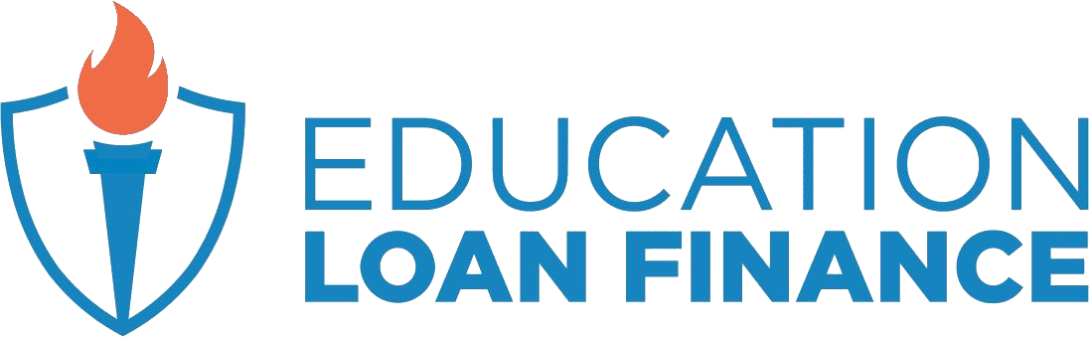

Our Competitors
Low Interest Rates
High Rejection
Low Rejection
Fair Chance
Competitors (For-profit lenders)
Supplementers (Non-profit lenders)
High Interest Rates
Intro
Problem
Customer
Competition
Solution
Financials
Current
Call-to-Action
Conclusion
Notes:
Create a map like shown to show where our niche is

Slide 7
Supplementing Existing Non-Profits
Low Interest Rates
We are not replacing existing non-profits. Instead, we are supplementing them by helping under-served students aka. “last-stretch” specialization.
We are replacing for-profit lenders.
High Rejection
Low Rejection
Intro
Problem
Customer
Competition
Solution
Financials
Current
Call-to-Action
Conclusion
Notes:
Create a map like shown to show where our niche is

Slide 8

Solution for Overlooked Students
Problem: federal financial aid is too selective
Novel, humanitarian FAIR SCORE
provides holistic applicant understanding
ML-generated (flexible, scalable, robust)
Deemphasize traditional “for-profit” metrics
Introduce important “non-profit” metrics
Identify those in need → reduce rejection rates, reach more students
Intro
Problem
Customer
Competition
Solution
Financials
Current
Call-to-Action
Conclusion

Slide 9


Traditional “FAFSA” Results
Not Helped
Helped
Intro
Problem
Customer
Competition
Solution
Financials
Current
Call-to-Action
Conclusion
Notes:
Almost 20% of those rejected are in strong need

Slide 10
FAIR SCORE Results
Helped
Intro
Problem
Customer
Competition
Solution
Financials
Current
Call-to-Action
Conclusion
Notes:
Almost 20% of those rejected are in strong need

Slide 11
Solution to High Interest Rates
Problem: financial aid is not enough; alternatives have high interest rate
FAIR RATE on every non-profit loan we give
0% interest while in school (subsidized)
Low interest while job searching (deferred)
Repayments only once they get a job (repayment)
Removing short-term financial burden → increases long-term student success
Intro
Problem
Customer
Competition
Solution
Financials
Current
Call-to-Action
Conclusion
Notes:
Using the novel Fair Score

Slide 12
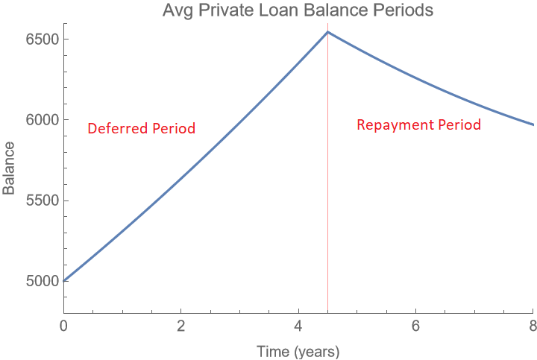
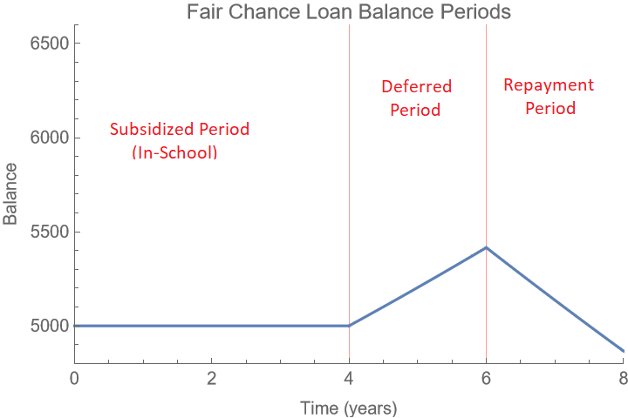
Loan Structure
Intro
Problem
Customer
Competition
Solution
Financials
Current
Call-to-Action
Conclusion
Notes:
Subsidized period (In-school) No payments and no interest accumulated
Deferred period (after graduation) No payments but interest starts to accumulate
Repayment period (2 yrs after graduation) Payments start

Slide 13
Loan Structure
$~3k savings
Intro
Problem
Customer
Competition
Solution
Financials
Current
Call-to-Action
Conclusion
Notes:
Subsidized period (In-school) No payments and no interest accumulated
Deferred period (after graduation) No payments but interest starts to accumulate
Repayment period (2 yrs after graduation) Payments start

Slide 14
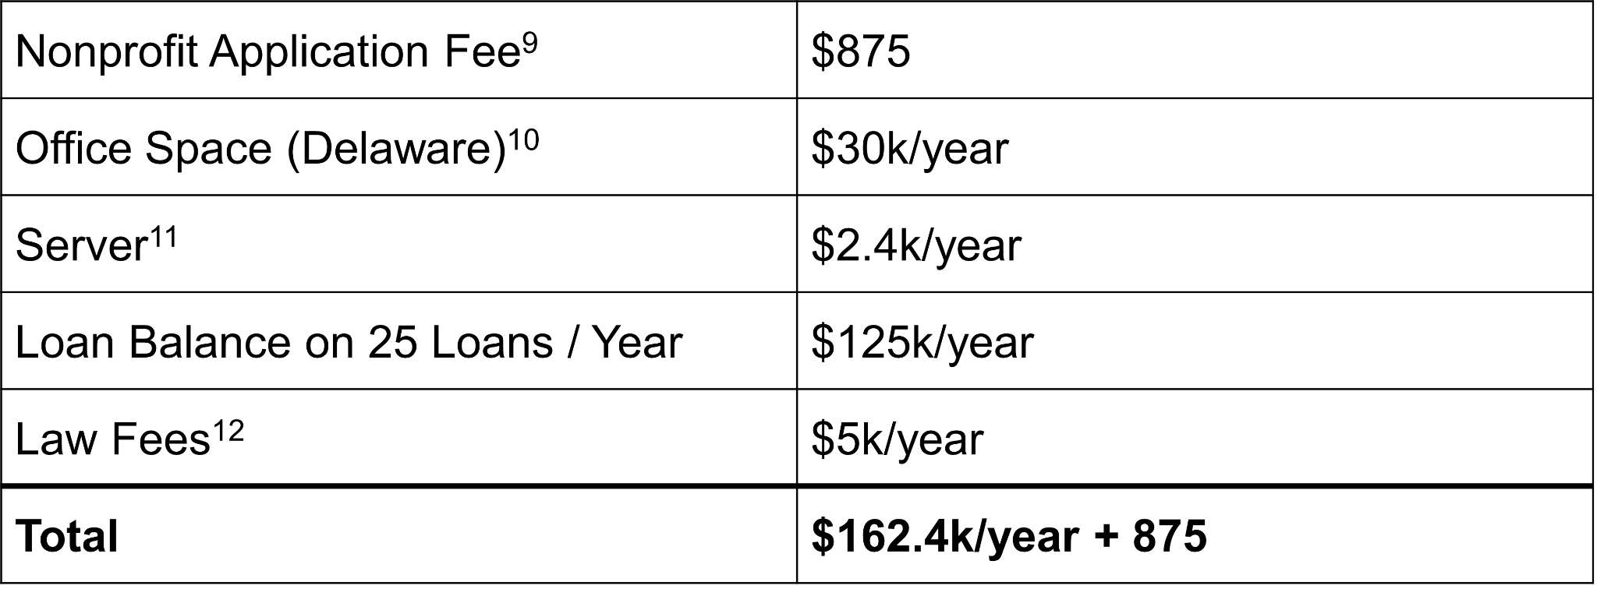
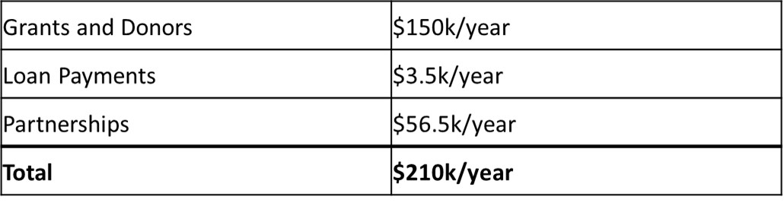
5 Year Financial Plan
Cost
Revenue
Intro
Problem
Customer
Competition
Solution
Financials
Current
Call-to-Action
Conclusion

Slide 15
Current Financial Plan
Cost
Capital Expenses Non-Profit Application Fee | $875
Operational Expenses Finalizing company details Improve AI-model Securing partnerships, get donors Expanding team | $0
First Loans 5 Students | $25k
Intro
Problem
Customer
Competition
Solution
Financials
Current
Call-to-Action
Conclusion

Slide 16
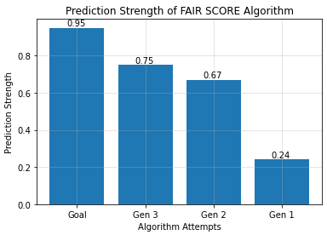
Current Progress: Working Prototype!
Live and working Prediction Algorithm | Github
Intro
Problem
Customer
Competition
Solution
Financials
Current
Call-to-Action
Conclusion

Slide 17
Current Progress: Working Prototype!
Live and working Prediction Algorithm | Github
Intro
Problem
Customer
Competition
Solution
Financials
Current
Call-to-Action
Conclusion

Slide 18


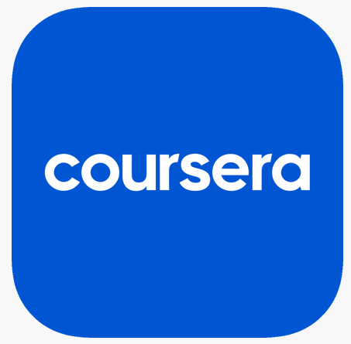

Call-to-Action: Looking Ahead
Seeking:
Investors, donors, partnerships (Khan Academy, Coursera, Udemy)
Applying to:
Coca Cola Foundation
3M Foundation
The Carnegie Foundation
Federal Grants
Recruiting for:
Legal, Accounting, HR
Intro
Problem
Customer
Competition
Solution
Financials
Current
Call-to-Action
Conclusion

Slide 19
Conclusion
FAIR CHANCE is non-profit, “last-stretch” lendor looking to help those underserved by traditional financial aid
FAIR CHANCE solutions:
(1) FAIR SCORE → better identify those in need
(2) FAIR RATE → remove financial burden of high interest rate
FAIR RATE’s business model
Subsidized, deferred interest rate
Repayments after they have full-time salary
Looking for investors, donors, partners, and potential employees
Intro
Problem
Customer
Competition
Solution
Financials
Current
Call-to-Action
Conclusion

Slide 20
Ready to give others
a Fair Chance?

Slide 21
Team
Bryan Denq • Marketing
bryandenq@gmail.com
Chris Denq • Technology
christopherdenq@gmail.com
Mark Lovett • Finance
lovettm0901@gmail.com
Special Thanks
Thank you!
Prof. Lew, Chief Advisor
Business & Entrepreneurship Club (BEC) for BIC 2022
Notes:
QA: quantify impact of solution? we are proof of concept for 25, attract donors and scale

Slide 22
References
[1] Virginia Commonwealth University. (2015, February 13). Why Education Matters to Health: Exploring the Causes. Center on Society and Health. Retrieved May 20, 2022, from https://societyhealth.vcu.edu/work/the-projects/why-education-matters-to-health-exploring-the-causes.html#:~:text=Education%20can%20also%20lead%20to,and%20may%20improve%20cognitive%20ability.
[2] College Board. (2021, October). Trends in College Pricing and Student Aid 2021. Retrieved May 20, 2022, from https://research.collegeboard.org/media/pdf/trends-college-pricing-student-aid-2021.pdf
[3] The state of student loans during the COVID-19 pandemic. (n.d.). Retrieved May 19, 2022, from https://files.consumerfinance.gov/f/documents/cfpb_student-loans-during-covid_infographic_2021-03.pdf
[3] Historical rates. Finaid. (2021, June 10). Retrieved May 18, 2022, from https://finaid.org/loans/historicalrates/
[4] Hanson, M., & Checked, F. (2022, April 11). Average student loan interest rate [2022]: New & existing loans. Education Data Initiative. Retrieved May 18, 2022, from https://educationdata.org/average-student-loan-interest-rate#:~:text=Student%20Loan%20Interest%20Rates&text=5.8%25%20is%20the%20average%20student%20loan%20interest%20rate%20among%20all,loan%20interest%20rate%20is%204.12%25
[5]The percent of students who receive financial aid. College Raptor Blog. (2021, November 23). Retrieved May 18, 2022, from https://www.collegeraptor.com/paying-for-college/articles/questions-answers/many-college-students-receive-financial-aid/
[6] Kantrowitz, M. (2022, April 14). How much money can you get from the FAFSA? Savingforcollege.com. Retrieved May 18, 2022, from https://www.savingforcollege.com/article/how-much-money-can-you-get-from-the-fafsa#:~:text=The%20amount%20of%20money%20you,in%20the%20form%20of%20grants.
[7] Federal Student Aid. (n.d.). What is my Expected Family Contribution (EFC)? Retrieved May 20, 2022, from https://studentaid.gov/help-center/answers/article/what-is-efc
[8] Kagan, J. (2022, March 25). 501(c)(3) organization. Investopedia. Retrieved May 18, 2022, from https://www.investopedia.com/terms/1/501c3-organizations.asp
[9] Form 1023 and 1023-EZ: Amount of user fee. Internal Revenue Service. (n.d.). Retrieved May 18, 2022, from https://www.irs.gov/charities-non-profits/form-1023-and-1023-ez-amount-of-user-fee
[10] Yardi Systems, I. (n.d.). Delaware Office & coworking spaces for rent – 578 listings. PropertyShark. Retrieved May 18, 2022, from https://www.propertyshark.com/cre/office/us/de/
[11] Amazon Web Services Simple Monthly Calculator. (n.d.). Retrieved May 18, 2022, from https://calculator.s3.amazonaws.com/index.html#key=CUSTOMER_SAMPLE_CALC_MARKETINGWEBSITE_140324&r=IAD&r=IAD
[12] Average cost of hiring a lawyer to draft a contract? Contract Lawyers: Compare Pricing and Save. (n.d.). Retrieved May 18, 2022, from https://www.contractscounsel.com/b/average-cost-of-hiring-a-lawyer-to-draft-a-contract
Created by Team FAIR CHANCE for BIC 2022; contact christopherdenq@gmail.com

Slide 23
Elevator Pitch 2
While education is often seen as a stepping stone towards better lives, money often stands in the way. In 2021 alone, the US totaled a staggering 1.7T dollars of debt overall, with interest rates on a steady rise. Unsurprisingly, students are forced to look for outside help in the form of financial aid, but even financial aid is tricky. School support is filled with bureaucracy, scholarships are competitive, and even FAFSA sometimes doesn’t give enough help. You’re forced into expensive private loans, working multiple stressful jobs, or worse… giving up on your educational dreams. It’s unfair that 6 million students need to make this decision every year, and it’s unfair that they never have a real chance to improve their lives.
This is where FAIR CHANCE comes in.
FAIR CHANCE is a dream startup that gives non-profit loans to students in need. We specialize in “last-stretch” financing, meaning whatever amount you’re missing to go school, we will fill in. We can do this with two major innovations in the lending space: (1) our newly invented FAIR SCORE, which is a machine learning algorithm that can better identify students in need and (2) our revolutionary FAIR RATE, which is on every non-profit loan we give
FAIR RATES are low impact and subsidized, meaning students don’t pay any money while they are in college and only pay us back once they have gotten a full-time job. This enables us to empower more students to confidently pursue their educational dreams and to focus on their own long-term success--all without the traditional financial burden. FAIR CHANCE aims to supplement existing non-profits like the FAFSA, while replacing the forced dependency on private lenders.
We currently looking for investors, donors, and partnerships, as well as, members to join our legal and accounting teams. We have already prototyped our FAIR SCORE algorithm, and are now looking to grow $10k in capital to build up our company, with the goal of helping 25 students in the starting year. With all that in mind, I’d like to ask you: are you ready to give others a FAIR CHANCE?

Slide 24
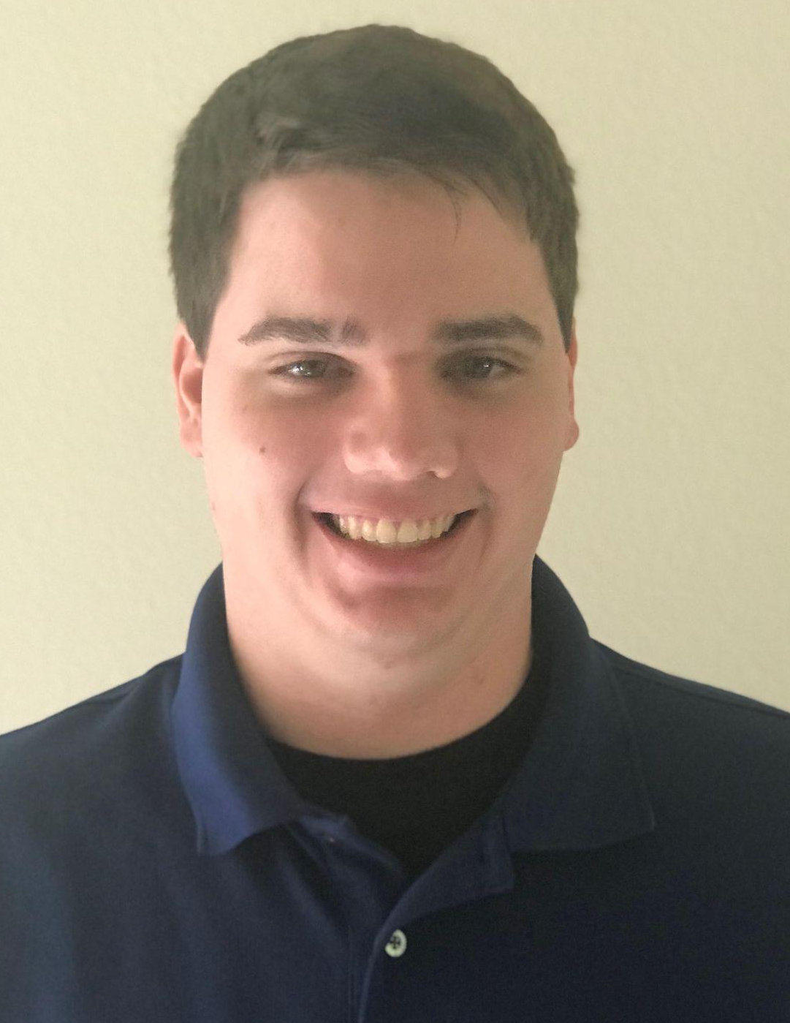


Team
Mark Lovett
Finance
Bryan Denq
Marketing
Christopher Denq
Data & Tech

